Slide 1
Marketing and Development Analysis for Hire Heroes, USA
By: Matt Giordano, Hunter Garfield and Kyle Hafey

Slide 2
Overview
Opened up social media campaign at beginning of 2014
Began Facebook/Twitter Registration service Dec. 18, 2015
Potential clients directed directly to registration page on website through Facebook
Ran ads on FB and Twitter through Hubspot starting April, 2015
Data on charitable donations starting 2012
Questions:
Can any registrants be traced directly to Dec. 18 registration service?
Is there a cause-effect relationship between marketing awareness and registration?
Is there a cause-effect relationship between social media presence and actual annual donations?

Slide 3
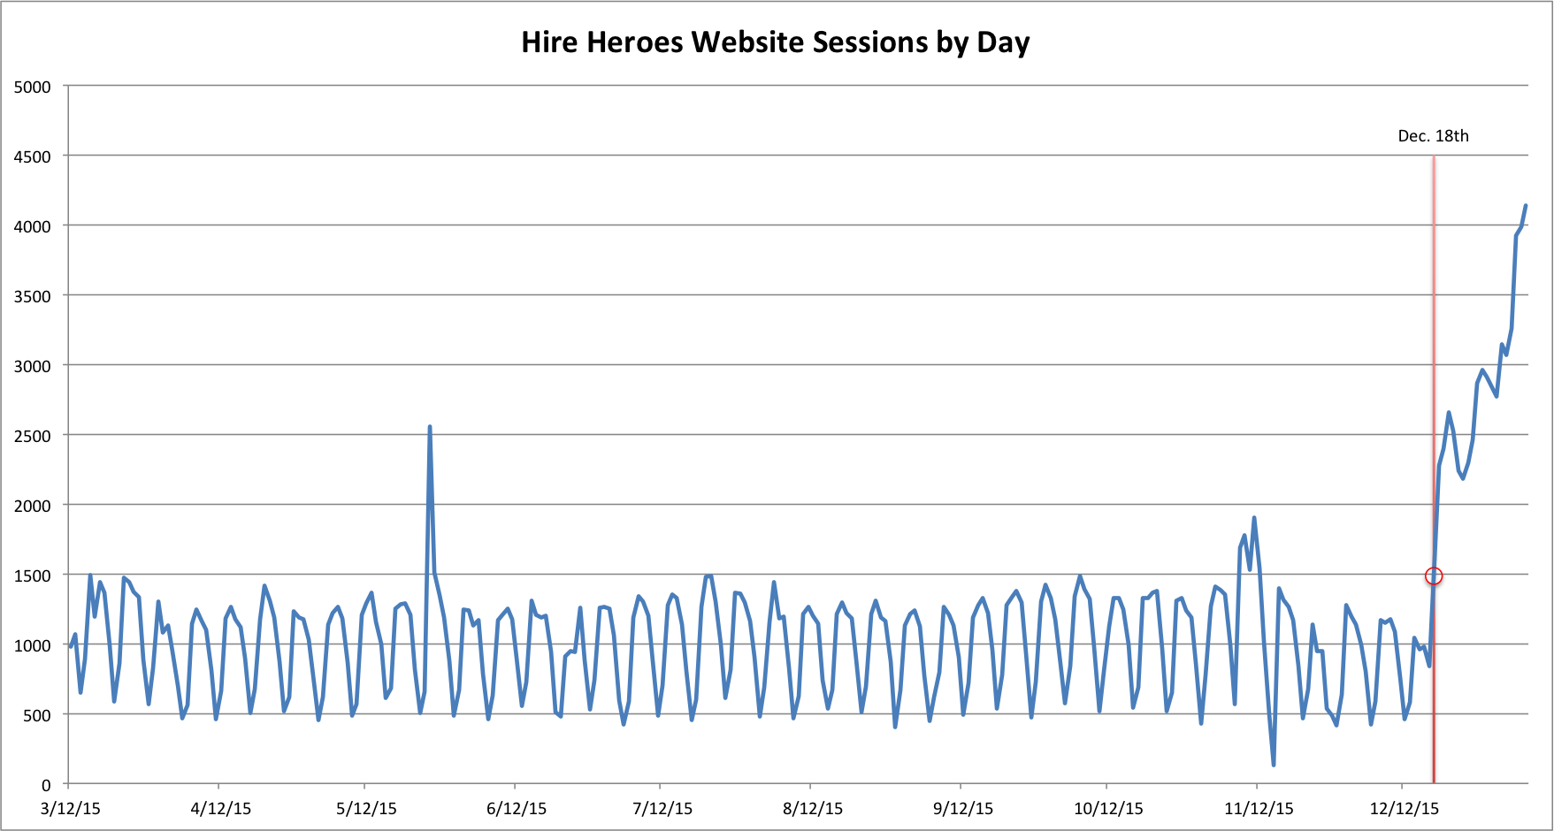
December 18th Registration Service
Regression results confirm Dec.18th registration service is associated w/ increased Sessions on website (1477 more, highly significant, adj.R² ≈ 45%)
Over whole period, after controlling for time
No significant changes to social media campaign around this period
But, we are concerned with registrants, not website sessions
* A session is a group of interactions on a website

Slide 4
Individual Registration & Registration Link Data
“/get-registered/” link takes user to registration page
No time breakdown given, only totals for pageviews, bounce rate, avg. time on page, etc.
Link is an outlier in terms of avg. time on page and bounce rate (both very high)
Suggests users spend time registering and leave when finished
Post-FB registration sessions account for roughly 20% of avg. growth in website sessions over the given period
Extrapolating this to “/get-registered/” data requires many unrealistic assumptions about the relationship b/w sessions and pageviews, % of viewers who register, etc.
Ultimately, lack of data on registrants is a huge hinderance to answering this question

Slide 5
Social Media and Registration
Regressed social media channel (FB, Twitter, LinkedIn), type of campaign, and dummy for after registration campaign started on number of ad clicks using hubspot advertisement data
All social media channels are significant predictors of user ad clicks
2.5 more clicks for FB, 9 more clicks for LinkedIn, 3.6 more clicks for Twitter, on average
More clicks on ads, on average, after Dec. 18th registration campaign
The veteran registration ad campaign is one of the few types of campaigns that is a significant predictor of clicks (associated with 1.8 more clicks on average)

Slide 6
Social Media and Registration
More people visit Hire Heroes website after the Dec. 18th registration campaign
More people click on ads that have to do with registering for Hire Heroes that any other type of ad
Can’t trace specific registrants to registration campaign (lack of data on registrants)
Likely that more people are visiting website due to registration campaign, more clicks on registration ads suggests more registrants based on the trend in website activity

Slide 7
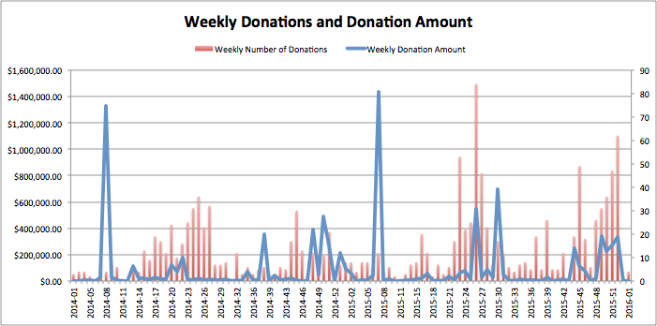
Donations Data
No statistical relationship between $ amt. of donations and number of donations received (even when accounting for outliers)
May have more donations given in a period but this does not necessarily generate more donation income
Can either $ donations or # of donations be explained by social media presence?

Slide 8
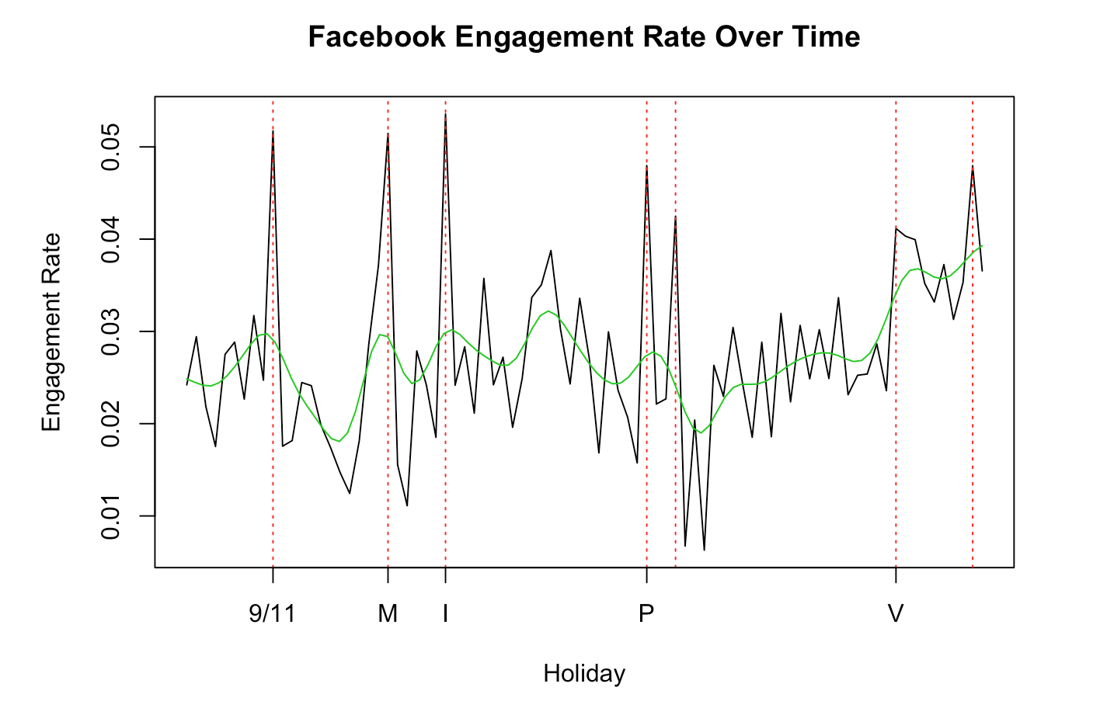
Has Social Media Presence Really Increased?
Here, we see peaks that correspond to military holidays
M is Memorial Day, I is Independence Day, P is Presidents Day, and V is Veterans Day. The two dashed lines that are not labeled represent the week of Christmas - or non-military related holidays
Seasonality
*Engagement Rate: Engaged Users/ Impressions

Slide 9
Moral of the story: NO
The graphs make it look like social media presence has increased. As it turns out, these peaks correspond with other companies giving out shoutouts to Hire Heroes USA.
We cross-referenced these peaks with what was posted on the social media sites, and the only reason the engagement rate was so high was because another page with more followers gave Hire Heroes, USA a shoutout.
We created the same graphs and analysis for the Twitter data, and we see the same results.
Their social media presence isn’t growing

Slide 10
Are Social Media and Donations Related?
No significant relationship between $ amount of donations and social media presence
Robust to measures of social media presence (new likes, dislikes, impressions, reach, engagement rate), and various lag specifications for social media posts
No significant relationship between number of donations and social media presence
Also robust
These analyses don’t account for the period preceding Facebook, Twitter, account set up

Slide 11
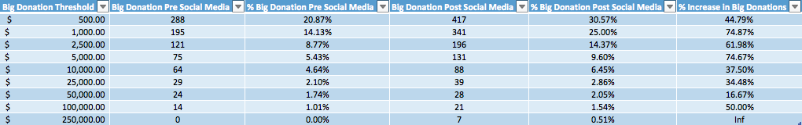
Causality Between Social Media and Donations cont.
Appears creating social media pages helped with donations at inception
Lack of growth in social media presence suggests these donations have remained stagnant with the exception of outliers

Slide 12
Conclusions/Recommendations
We did not want to torture the data to obtain results we expected
We could not trace specific registrants to the Dec. 18, 2015 ad campaign
There was not enough data since Dec.18, 2015 to establish a causal effect of the social media campaign on registration, but there is evidence that more people visit the website and more people click on the Hubspot registration links
Data suggests establishing a social media presence led to more large donations.
However, lack of growth in social media presence has contributed to stagnation in donations
Sporadic donations to Hire Heroes are related to the social media spikes and partnerships with larger social media sources

Slide 13


